Slide 1
Predicting Student Success
Francis Doran

Slide 2
Contents
Introduction
Primary goals
Data Overview
Methodology
Model Interpretation

Slide 3
INTRODUCTION
College is a high stakes endeavor; it will probably be the biggest change in one’s life up until that point and it can shape the trajectory of the rest of one’s life. As such it is important to be able to ensure that students don’t squander their opportunity and to that end it is imperative to be able to assess the risk of students dropping out and be able to put intervention in-place early. A malady is often easy to treat in the beginning but difficult to detect, and easy to detect in the end but difficult to treat.

Slide 4
PRIMARY GOALS
The goal of this project is to take student data and predict whether they will have dropped out of college, graduated, or still be enrolled in their undergraduate degree, after a reasonable amount of time and to identify the key features in making this prediction.

Slide 5

I chose XGBoost for its efficiency, effectiveness, and ability To address class imbalance.

Slide 6
XGBoost before optimization
​ | Precision | Recall | F1-Score | Support
Dropout | .82 | .74​ | .78​ | 284
Enrolled | .55 | .45​ | .50 | 159
Graduated | .81​ | .91​ | .86 | 442
Accuracy | ​ | ​ | .78​ | 885

Slide 7
Optimization
Step 1
Hyperparameter optimizer
Step 2
Class weight optimizer
Step 3
Model rating
Step 4
Repeat while results are improving

Slide 8
XGBoost After optimization
​ | Precision | Recall | F1-Score | Support
Dropout | .88 | .74​ | .79 | 284
Enrolled | .49 | .72 | .59 | 159
Graduated | .87​ | .82 | .84 | 442
Accuracy | ​ | ​ | .77 | 885

Slide 9
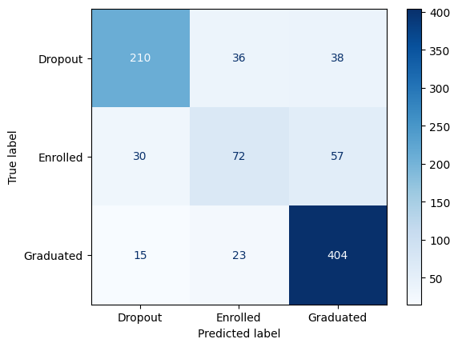
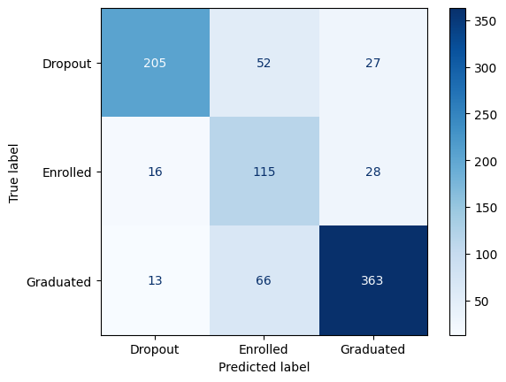
Confusion Matrix
Initial
Final

Slide 10
Model Interpretation
Using pdpbox and shap

Slide 11
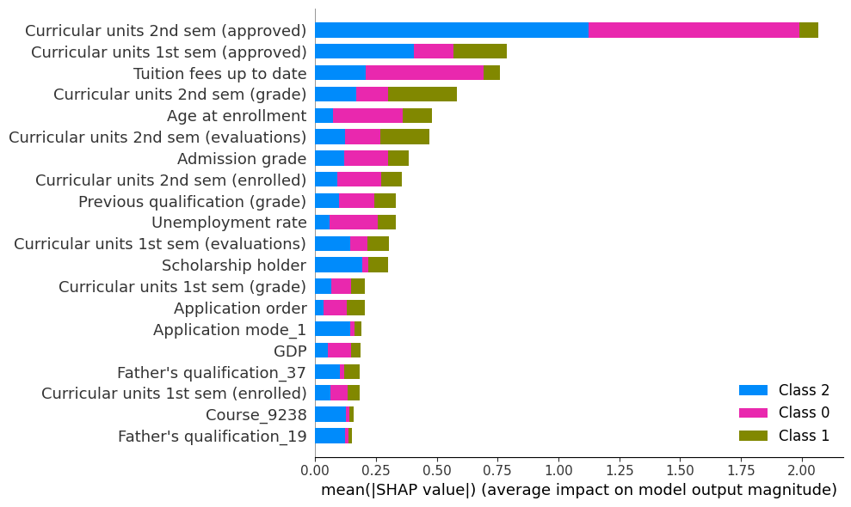
Shap tree explainer

Slide 12
TOP features
7th most important with a relatively even impact on predictions
2nd Semester Approved Units
Most important by a large margin, very important for predicting both graduates and dropouts.
Tuition Fees Up to Date
3rd most important, with large impact on predicting dropouts
2nd Semester Grades
4th most important with large impact on predicting enrolled students.
5th most important with large impact on predicting dropouts
Admission Grades
Age at Enrollment

Slide 13
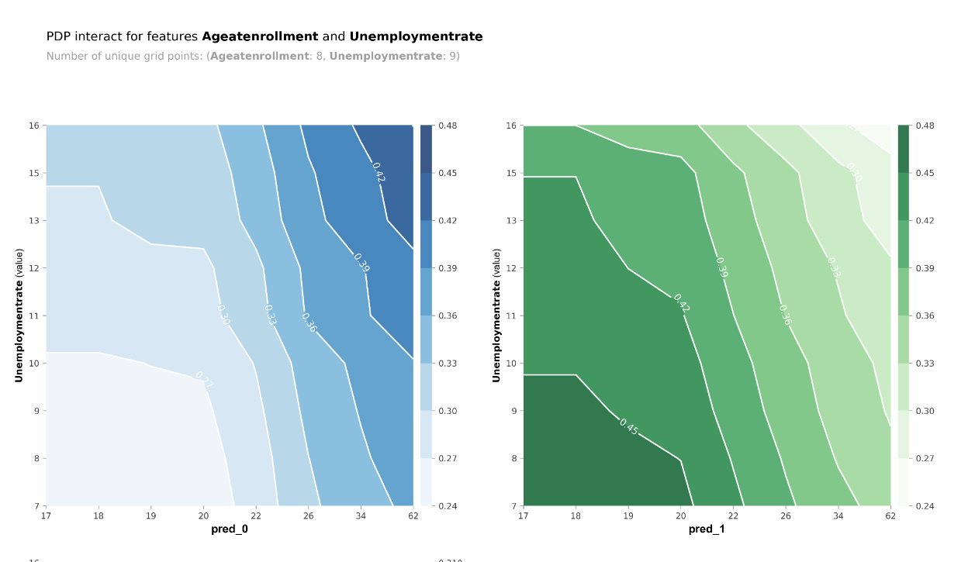
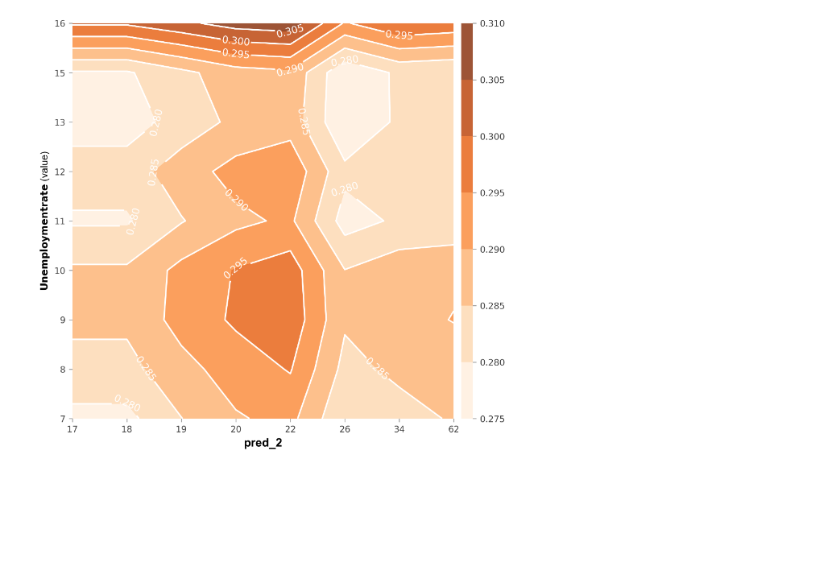
Unemployment rate matters less as age at enrollment increases
ROI
NICHE MARKETS
SUPPLY CHAINS
Envision multimedia-based expertise and cross-media growth strategies​
​Engage worldwide methodologies with web-enabled technologies​
Pursue scalable customer service through sustainable strategies​
Engage top-line web services with cutting-edge deliverables​​​
Cultivate one-to-one customer service with robust ideas​
Maximize timely deliverables for real-time schemas​

Slide 14
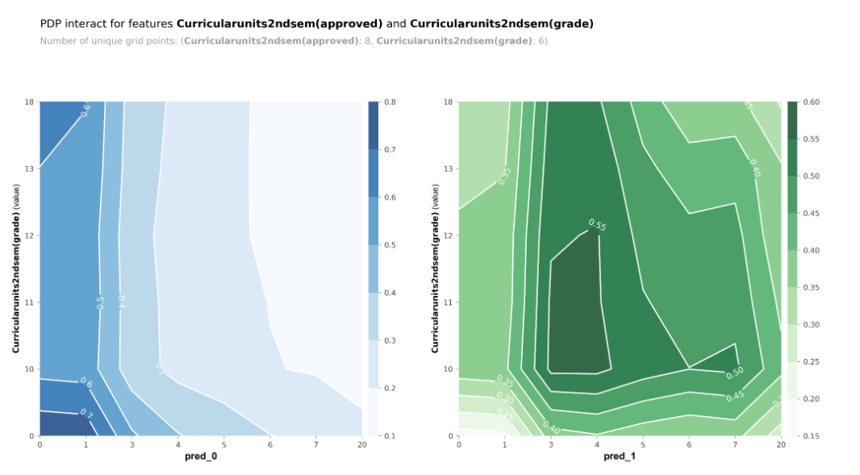
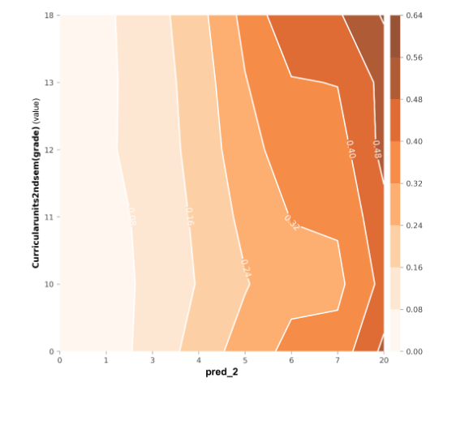
Passing classes is more important than grades
CLOUD-BASED OPPORTUNITIES
Develop winning strategies to keep ahead of the competition
​Capitalize on low hanging fruit to identify a ballpark value
​Visualize customer directed convergence​
Iterative approaches to corporate strategy
​Establish a management framework from the inside​

Slide 15
THANK YOU

